Slide 1
TransCanyon Proposal for Modeling Cross-Tie Resources for NorthernGrid Analysis
DRAFT
February 10, 2021

Slide 2
Cross-Tie Transmission Project
The Cross-Tie Transmission Project (Cross-Tie Project) is a proposed 213-mile, 1500 MW, 500 kV HVAC line
Cross-Tie will be constructed between central Utah and east-central Nevada (see Figure 1)
The project benefits include:
Strengthen the electrical interconnection between the PacifiCorp and the NV Energy transmission systems
Support interregional power transfers by linking NorthernGrid, WestConnect and CAISO planning regions to provide interregional power transfers
Facilitates California’s RPS and GHG requirements by moving Wyoming wind and Utah solar to California.
The Cross-Tie Project’s Project Review Group approved Phase 2B status with a planned bidirectional rating of 1500 MW on January 31, 2019

Slide 3
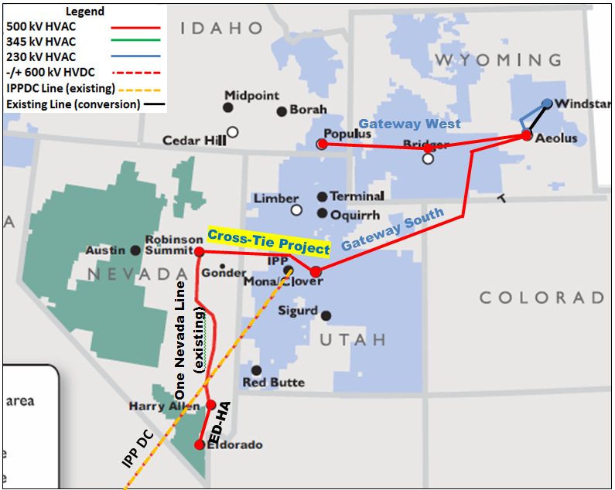
Cross-Tie Transmission Project

Slide 4
NorthernGrid (NG) Proposal for Resource Dispatch
NG has identified nine hours to model as base cases from the annual production cost model
The first eight will be used to study Cross-Tie
Dispatch determined from NREL data (wind) and historical data (solar)
Case | Name | Date | Hour | Solar and Wind Capacity Added | Dispatch
BC1 | HS | 7/30 2030 | 16 | 7481 | 2306
BC2 | HW | 12/10 2030 | 19 | 7481 | 2238
BC3 | High WY | 2/1 2030 | 1 | 7481 | 1716
4 | High ID- NW | 7/20 2030 | 17 | 7481 | 3754
5 | High Borah W | 9/1 2030 | 1 | 7481 | 2447
6 | Northbound COI | 3/10 2030 | 15 | 7481 | 6693
7 | West of Cascades | 4/3 2030 | 11 | 7481 | 2568
8 | COI/PDCI High Hydro | 6/4 2030 | 18 | 7481 | 2360
9 | NG Combo Case | 6/8 2030 | 5

Slide 5
Resource Modeling Proposal
Use dispatch per above
Should be sufficient resources to stress Cross-Tie line in most cases
BC6 (Northbound COI) with 6693MW dispatch will likely not solve
As one of the Cross-Tie project’s major benefits is to allow renewable resources in Wyoming and Utah to move through Nevada to California we propose reducing a like amount of generation in Southern California to balance system
Use SCE and SDG&E areas and scale resources to reduce by incremental solar and wind dispatch in each case
Example: BC1 would scale back Southern California Resources by 2306MW

Slide 6
Questions?

