Slide 1
Enrolled Parties and States Committee
June 24, 2026
Chelsea Loomis, Western Power Pool

Slide 2
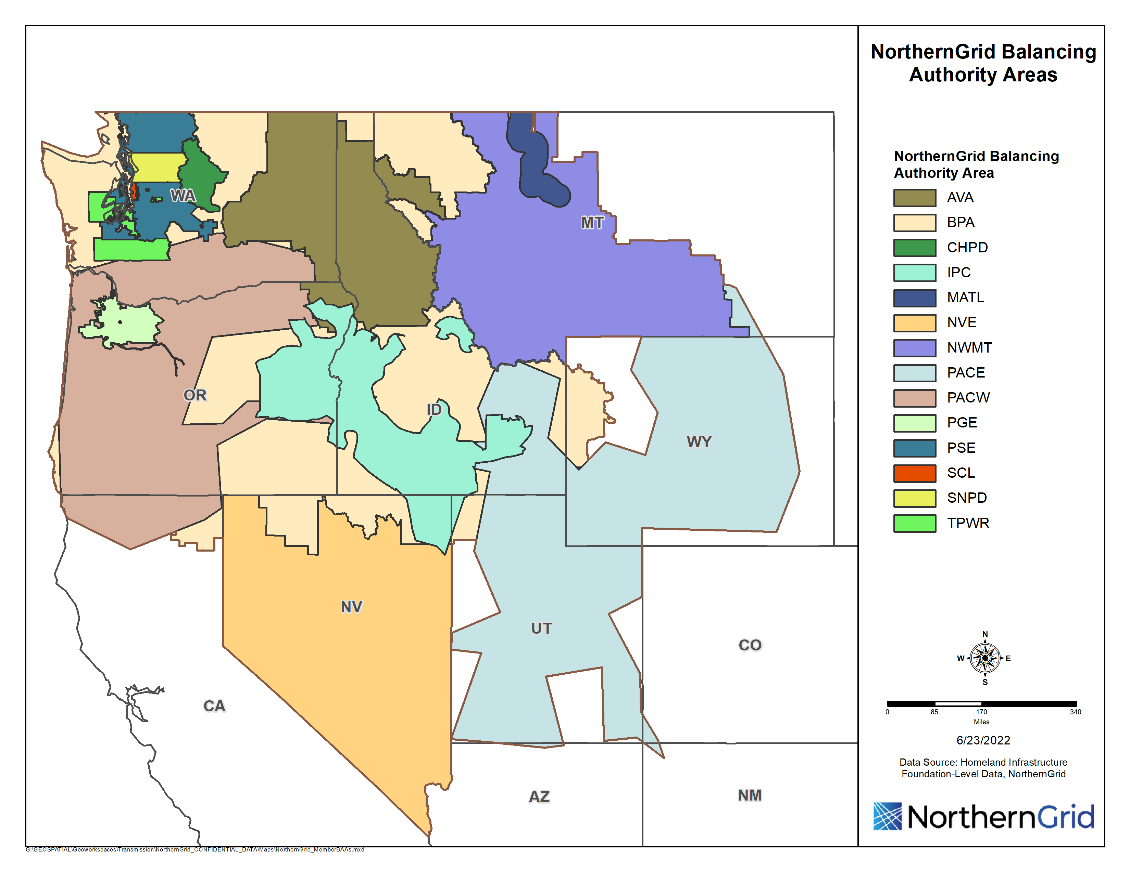














Slide 3

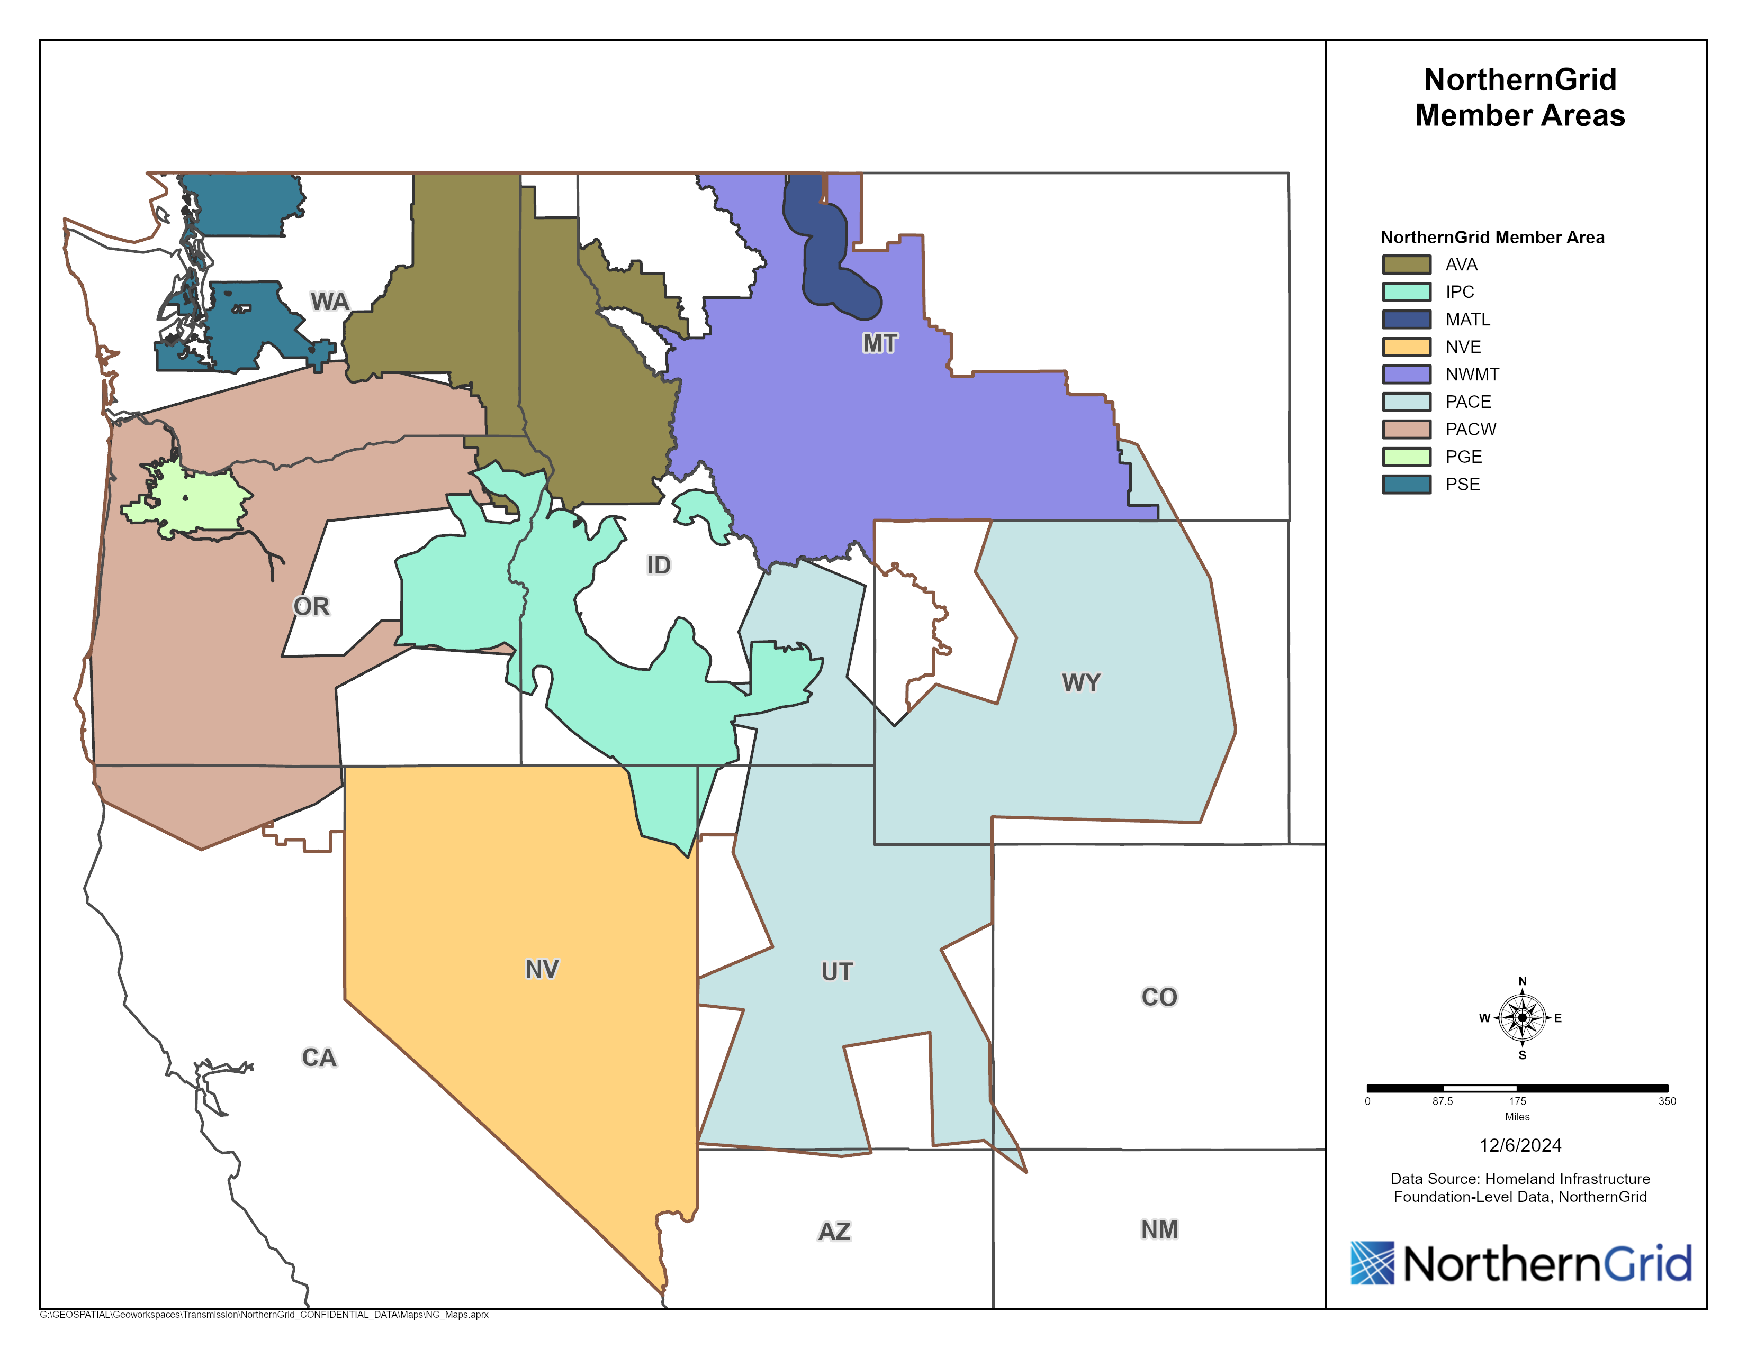
NorthernGrid footprint map
Notes:
Chelsea

Slide 4
Committee Functions
Member
Member Planning
Enrolled Parties Planning
Enrolled Party and States
Cost Allocation Task Force
Membership
Budget
Vendor
Stakeholders
Study Scope
Transmission Plan
Facilitate FERC compliance
Study Scope Contributions
Prequalification
Benefit and cost allocation
Plan Comments

Slide 5
EPSC Membership
Organization |  |  | Enrolled Party
Idaho PUC | Representative |  | Avista | Representative | April Spacek
 | Alternate | Stephen Goodson |  | Alternate | Kenny Dillon
Idaho OER | Representative | Cally Younger | Idaho Power | Representative | Jared Ellsworth
 | Alternate | Jett Hawk |  | Alternate | Stephen Longmuir
Montana PSC | Representative | Haylee Gobert | MATL | Representative | Sharmen Andrew
 | Alternate | Will Roquist |  | Alternate | Jakob Mawdsley
Montana Consumer Counsel | Representative | Jamie Stamatson | NorthWestern Energy | Representative | Melissa Crosby
 | Alternate | Paul Schulz |  | Alternate | Ryan Munson
Nevada PUC | Representative | Gary Cameron | NV Energy | Representative | Charlie Pottey
 | Alternate |  |  | Alternate | Francis DeVera
Oregon PUC | Representative | Les Perkins | PacifiCorp | Representative | Kris Bremer
 | Alternate | Sudeshna Pal |  | Alternate | Eva Kwitman
Oregon DOE | Representative | Jason Sierman | PGE | Representative | Graham Retzlaff
 | Alternate | Edith Bayer |  | Alternate | Jennifer Galaway
Utah Department of Commerce | Representative | Chris Parker | PSE | Representative | Eleanor Ewry
 | Alternate | Brenda Salter |  | Alternate | Pete Jones
Utah Office of Energy Development | Representative | Lindsey Mayer
 | Alternate
Washington UTC | Representative | Brian Rybarik
 | Alternate | Nezih Evren
Washington | Representative | Glenn Blackmon
 | Alternate | George Lynch
Wyoming PSC | Representative | Christopher Petrie
 | Alternate
Co-Chairs for 2026-2027
Enrolled Party: Stephen Longmuir, IPC
State: ___________________________

Slide 6
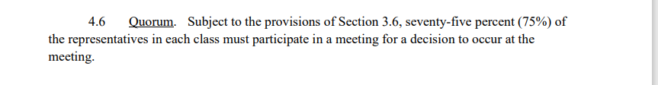
EPSC Governance
Transmission Planning Process (Charter, page 88)
Proposal: Use FORMS to make nominations May 2026 for vote in June 2026

Slide 7
EPSC Leadership Proposal
Alphabetical by State
Enrolled Party Co-Chair
Stephen Longmuir, IPC
States Co-Chair Proposal:
Washington UTC, Brian Rybarik
Vote on States Co-Chair

Slide 8
Current Activities for NorthernGrid
Enrolled Parties have recently filed their FERC Order 1920 Attachment K Language
2026-2027 Study Scope V0 posted
  Mandatory 60-day period just closed
NorthernGrid Technical Team up and running
  Tech Team agendas will be publicly posted, however, discussions closed to NorthernGrid Members
NorthernGrid.net recently upgraded
  Please be sure to accept invite and check displayed information

Slide 9
2026-2027 Review of Draft Study Scope
NG_Study_Scope_2026_2027_Draft_V0.pdf
26_27_V0_Study_Scope_Comments.pdf

Slide 10
Up Next on Deck
Update 2026-2027 Scope by June 30
Anticipate approval at July 15 MPC
Reminder that all monthly MPC meetings open to public

Slide 11
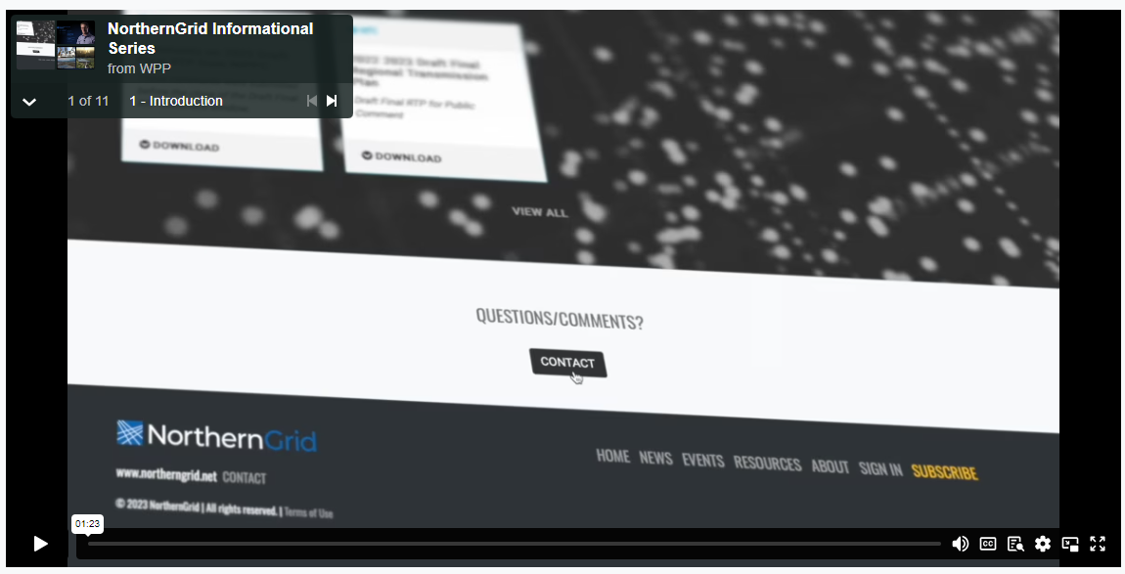
NorthernGrid Informational Series
Intro
FERC Orders
Resource Planning vs Transmission Planning
Participants in the NorthernGrid Planning Process
Walk-Through of the Planning Cycle
What is the Regional Transmission Plan
Technical Studies
Economic Studies
Cost Allocation
Cost Allocation Benefits & Payments
Role of the State
NorthernGrid

Slide 12


Thank you!
Chelsea Loomis
Western Power Pool
NWPP_NorthernGrid_Staff@westernpowerpool.org
503.445.1082
https://www.Northerngrid.net

