Slide 1
March 26, 2024
Annual Interregional Coordination Meeting
Enoch Davies
Manager, Reliability Modeling

Slide 2
Topics
ITCS update
Long-term/20-year dataset
ADS update

Slide 3
Interregional Transfer Capability Study

Slide 4
Interregional Transfer Capability Study
Interregional Transfer Capability Study = ITCS
What is Transfer Capability?
Total transfer capability: the amount of electric power that can be moved or transferred reliably from one area to another area of the interconnected transmission systems by way of all transmission lines (or paths) between those areas under specified system conditions, or such definition as contained in Commission-approved Reliability Standards.
MW
Area
“A”
Area
“B”
Area
“C”

Slide 5
ITCS Project Overview
Fiscal Responsibility Act of 2023, Section 322
Congress directed that, in consultation with the Regional Entities and transmitting utilities, NERC shall conduct a study containing three elements:
Phase 1 Objective: Determine the total transfer capability between neighboring transmission planning regions.
Phase 2 Objective: Identify “prudent” additional transfer capability between neighboring areas to resolve reliability issues in the future.
Phase 3 Objective: Identify mechanisms to achieve and sustain the identified transfer capability and any recommended enhancements.

Slide 6
What the Study is NOT
Planning study
Replacement for Transmission Expansion Analysis and Interregional Planning groups
No recommendations for specific projects (generation, transmission, etc.)
Will focus on what … not how
A complete or final solution

Slide 7
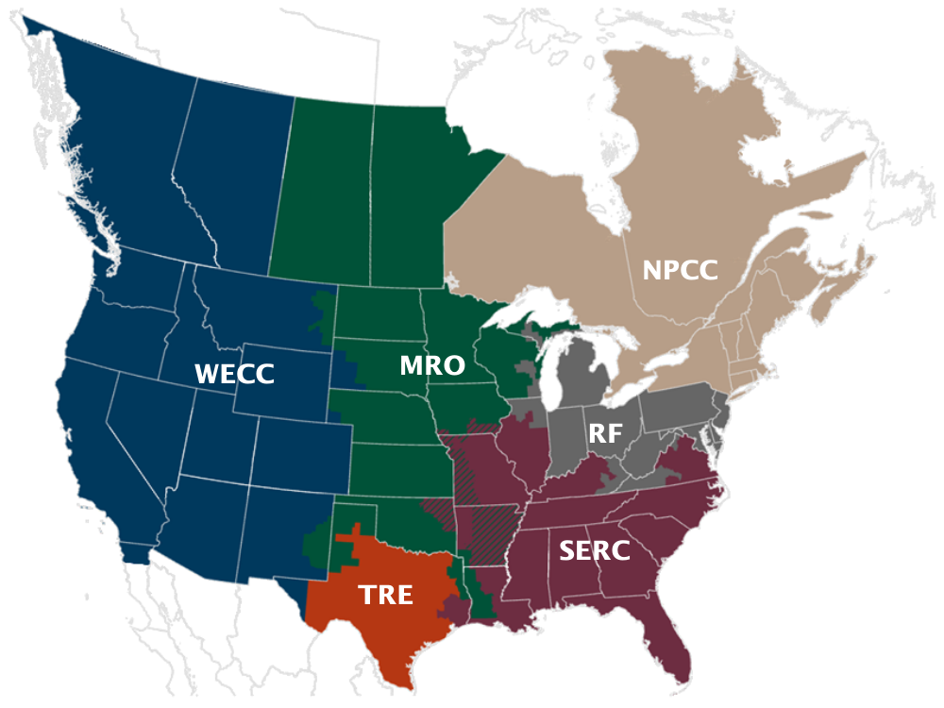
Entities Involved
NERC and the six Regional Entities in consultation with transmitting utilities
NERC Advisory Group
WECC Advisory Group
Contractors—PowerGEM and Telos Energy
Notes:
VIC – please note during this slide that periodic and intentional stakeholder opportunities – such as this discussion – are being created as the project moves forward in order to keep the stakeholders apprised of the progress and development of the study (thanks – Kris)

Slide 8
ITCS Timeline Overview
Fiscal Responsibility Act of 2023
June 3, 2023
Study Cases Prepared and Initial Actions Complete
January 31, 2024
ITCS Executive Committee Project Kick-off
August 11, 2023
Recommendation for Prudent Additions Complete
August 30, 2024
Transfer Analysis Complete
July 1, 2024
Report submitted to FERC
December 2, 2024
FERC Approval of NERC Transmission Study Budget
August 10, 2023
ITCS Advisory Group Kick-off
October 31, 2023
Notes:
Should we include for our presentation where we sent out the data request in the WI?? Also – this looks a little sparse. Are there other things along the timeline that would be reasonable to include? Maybe the advisory meetings??? Or identify PHASE ONE and PHASE TWO????

Slide 9
Phase 1: Method
Calculate current transfer capability (in years 2024 and 2033)
Create run-of-the-mill base cases (summer peak, winter peak, etc.)
Identify source/sink combinations
Identify contingencies
Identify RAS schemes to be modeled
Develop assumptions that represent extreme/maximum transfer conditions
Identify stability limitations (if any)
Represent and simulate the extreme/maximum transfer conditions in the cases created in Step 1.a and calculate transfer capability for each of the source/sink combination (bidirectional)

Slide 10
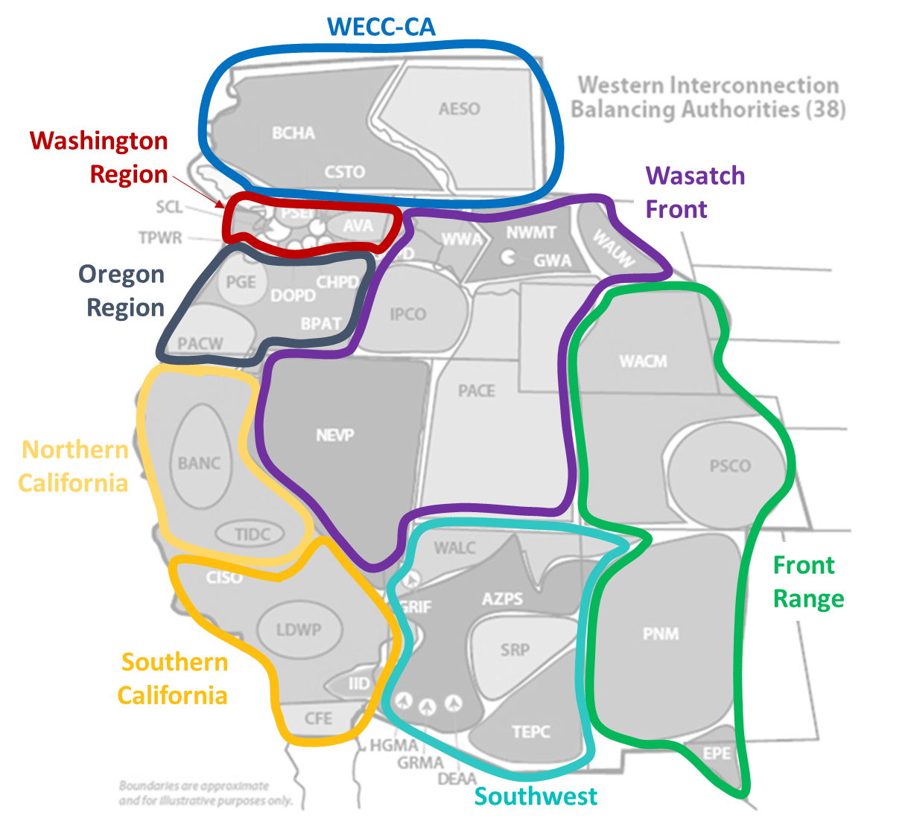
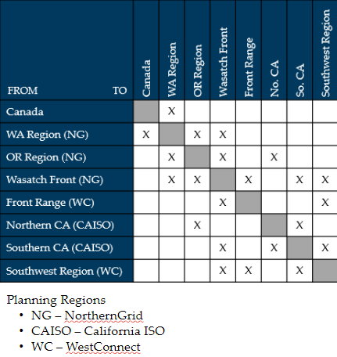
Source-Sink Areas

Slide 11
Phase 1: Cases and Contingencies
Study four cases from the West
2024 Heavy Summer
2023/2024 Heavy Winter
2033 Heavy Summer
2033/2034 Heavy Winter
Apply adverse system conditions (contingencies) to each case
Data request sent and responses received
Sent November 2023, responses due January 17, 2024
Notes:
New generation: Generation with a signed ISA should be included in the future year cases
Planned retirements: Generation that has retired or has announced retirement should be removed from the appropriate cases
Facility Ratings
Expected long-term facility outages
Transmission system topology

Slide 12
Phase 1: Next Steps
Provide updated cases to NERC
Work with PowerGem to find the max transfer capability between the source/sink combinations
If issues arise, work with stakeholders to validate and mitigate
Meeting with WECC Advisory Group on 3/5 to discuss reviewing results

Slide 13
Phase 2: Energy Assessment
Perform Energy Assessment (in years 2024 and 2033)
Identify system conditions under which system will experience energy shortfalls
Determine prudent additions to interregional transfer capability between each pair of transmission planning region
Evaluate which planning area(s) are prudent to increase transfer capability

Slide 14
Phase 2: Energy Assessment
Transmission vs. Generation Options
Extreme weather events only considered
Scenarios will consider multiple risk factors (drought, cold / heat wave)
Time-synchronized hourly assessment of load and generation to capture geographic diversity
Calculate Hourly Energy Margin—An hourly measure of resource availability relative to load and operating reserve requirements, factoring weather dependencies of load, hydro, wind, solar, and thermal generators, applied consistently across all regions

Slide 15
Phase 2: Next Steps
Perform Energy Assessment (in years 2024 and 2033)
Develop a consistent North American dataset
U.S. data collected
Sending data request to Canadian provinces asking for historical hourly generation by resource type
Identify periods of tight supply conditions
Develop metrics and methods
Re-dispatch transmission planning cases

Slide 16
January 25 NERC Advisory Group Meeting
Project and timeline overview and actions completed
Phase 1 and Phase 2 review, technical discussions
Transmitting utility engagement
Discussion—What does success look like to you? What does it not look like?
Next steps and advisory group meeting schedule
Monthly advisory group virtual meetings
In-person meeting in October

Slide 17
NERC AG Success Poll Results
What does success look like?
Actionable
Repeatable
Increased communication and coordination
Alignment
Clear
What is not success:
Put on the shelf
Continued disconnect
Not actionable
Deeply technical

Slide 18
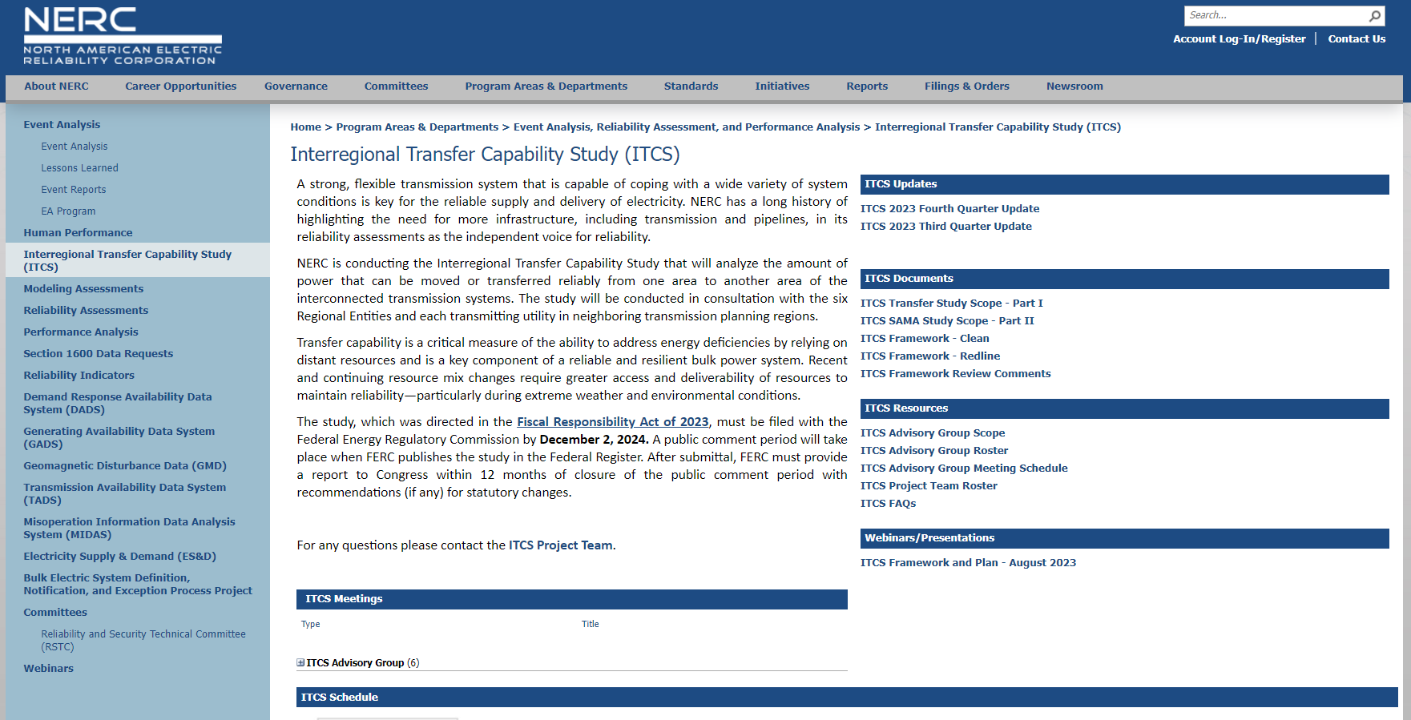
ITCS Resources
NERC ITCS webpage
NERC ITCS Advisory Group Meeting Schedule​​
WECC Weekly Update
WECC website
Email us at engage@wecc.org
Notes:
NERC ITCS webpage https://www.nerc.com/pa/RAPA/Pages/ITCS.aspx
NERC ITCS Advisory Group Meeting Schedule​​ https://wecc4.sharepoint.com/sites/ITCSProject/Shared%20Documents/General/01-31-2024%20ITCS%20Status%20Update/ITCS%20Advisory%20Group%20Meeting%20Schedule​​
WECC Weekly Update
WECC website https://www.wecc.org/Pages/home.aspx
Email us at engage@wecc.org

Slide 19
Long Term/20+ Year Data

Slide 20
Long-term Transmission Planning Task Force
WECC releases Long-term Transmission Planning in the West—October 2022 RAC Workshop Discussion Summary and Next Steps paper in June of 2023
Task force established in October 2023
Meetings are scheduled biweekly
From LTPTF Charter: The purpose of the LTPTF is to make recommendations to the RAC concerning aspects of long-term transmission planning (20+ years). The recommendations should include defining a modeling approach, datasets, tools, and scenario development

Slide 21
Discussions To-date
Understanding of other efforts in-flight
WestTEC, Gridworks, PJM new LTRTP, FERC 2023 NOPR, etc.
Preliminary findings:
WECC role would be to collect and maintain datasets, but not to complete long-term system planning studies or propose projects
Potential use cases for the data should drive associated requirements
Datasets would likely include production cost models and power flow (i.e., bus-branch models); dynamic models not currently in scope due to diminishing returns on effort
Ongoing discussion:
Anticipated FERC decision on long-term planning will shape stakeholder needs
Source (and process) of the data for assumptions on future load, generation, and transmission projects
Role of WECC for sensitivity cases and if/what should be explored in a long-term dataset

Slide 22
Potential Use Cases Identified To-date
Transmission planning entities to propose new major transmission projects
Transmission planning entities to develop longer views and trends that can impact the scopes for mitigations identified through conventional transmission planning processes
Transmission planning entities to meet FERC requirements
Transmission planning entities to explore technology needs*
Resource planning entities and transmission planning entities can work together to iterate on the IRP process
*While noted as a potential use for this data, exploring specific technology (e.g., grid-forming inverters) would likely require dynamic data that was considered out of scope for this case development effort

Slide 23
Background Studies
Nationwide 10+ Years
FERC NOPR, PJM LTRTP, ITCS
Western 10+ Years
WestTEC, CAISO 20-year Transmission Outlook and TPP, WA/OR Regional Assessment, CETA Transmission Study
Studies focused on FERC NOPR sensitivities
Extreme weather
Climate
National Labs/Other

Slide 24
Anchor Data Set Update

Slide 25
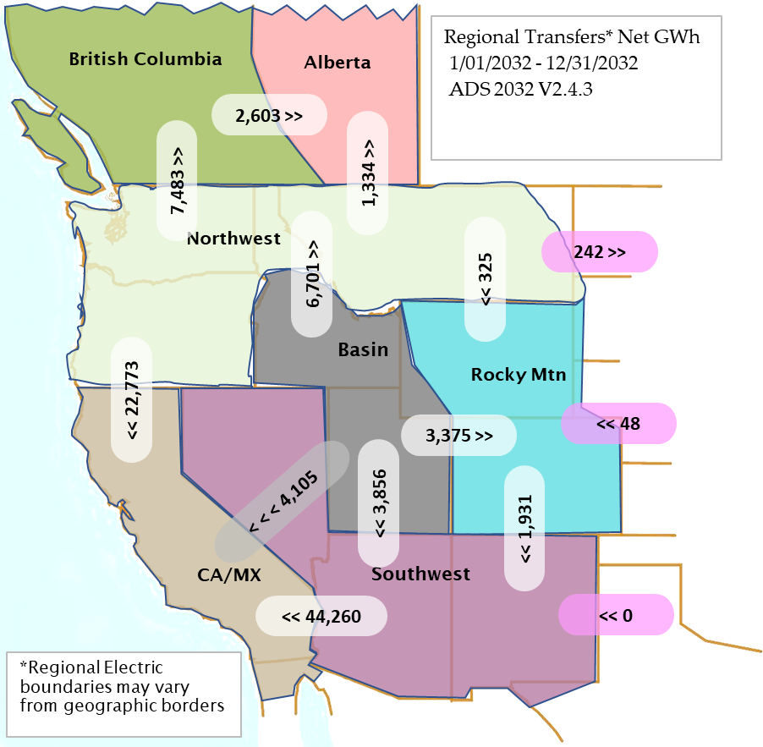
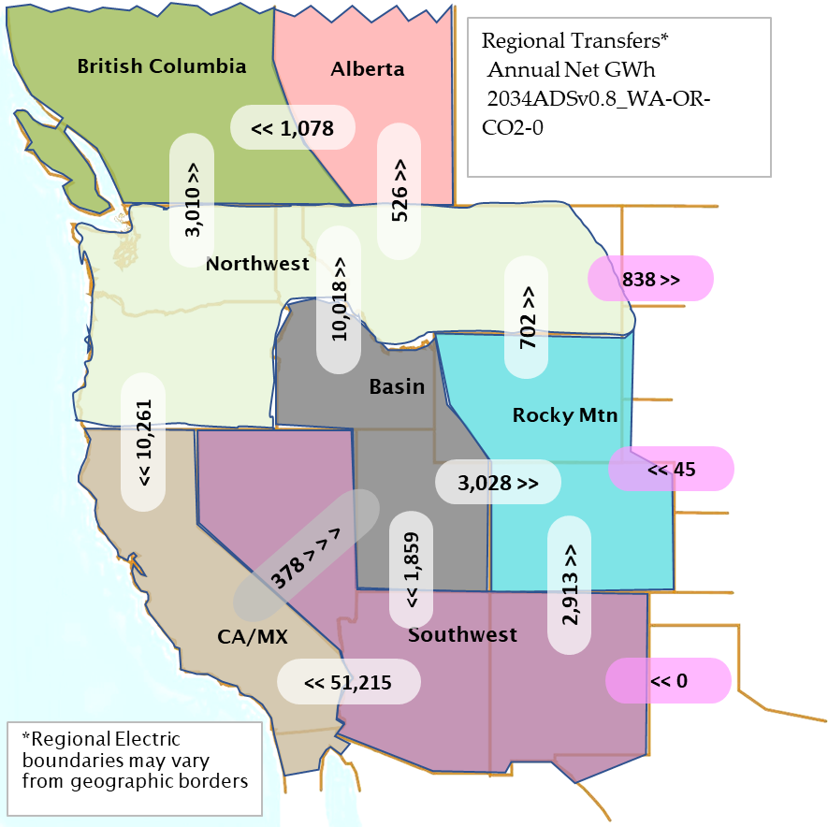
Regional Transfers CO₂ Price WA/OR $0

Slide 26
Net Annual Flow

Slide 27
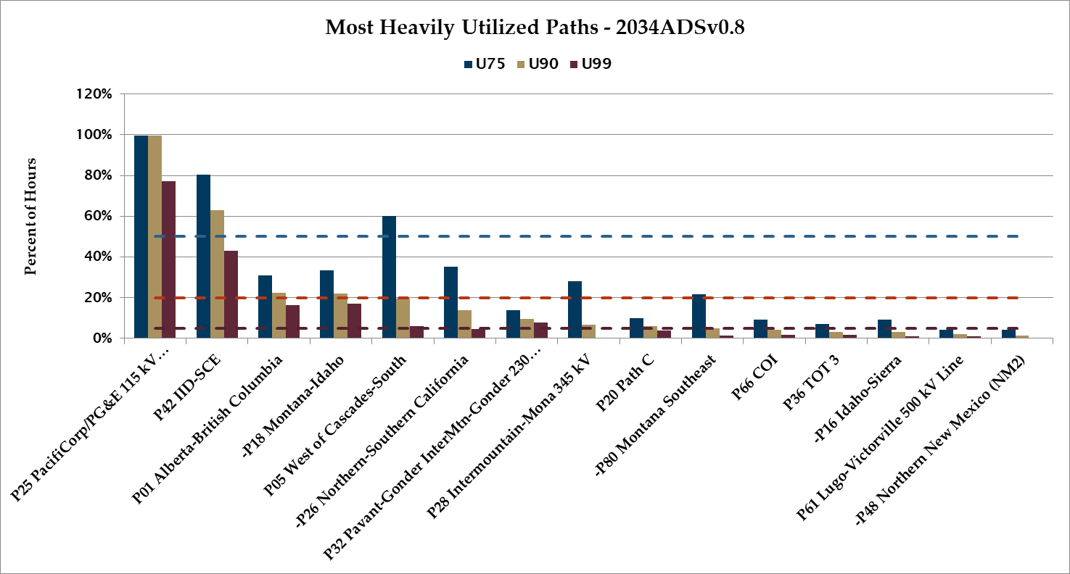

Slide 28
P65 PCDI

Slide 29
P26 N-S CA

Slide 30
P66 COI

Slide 31
P46 WOR

Slide 32
P27 IPP DC

Slide 33
P49 EOR

Slide 34
P31 TOT2A

Slide 35
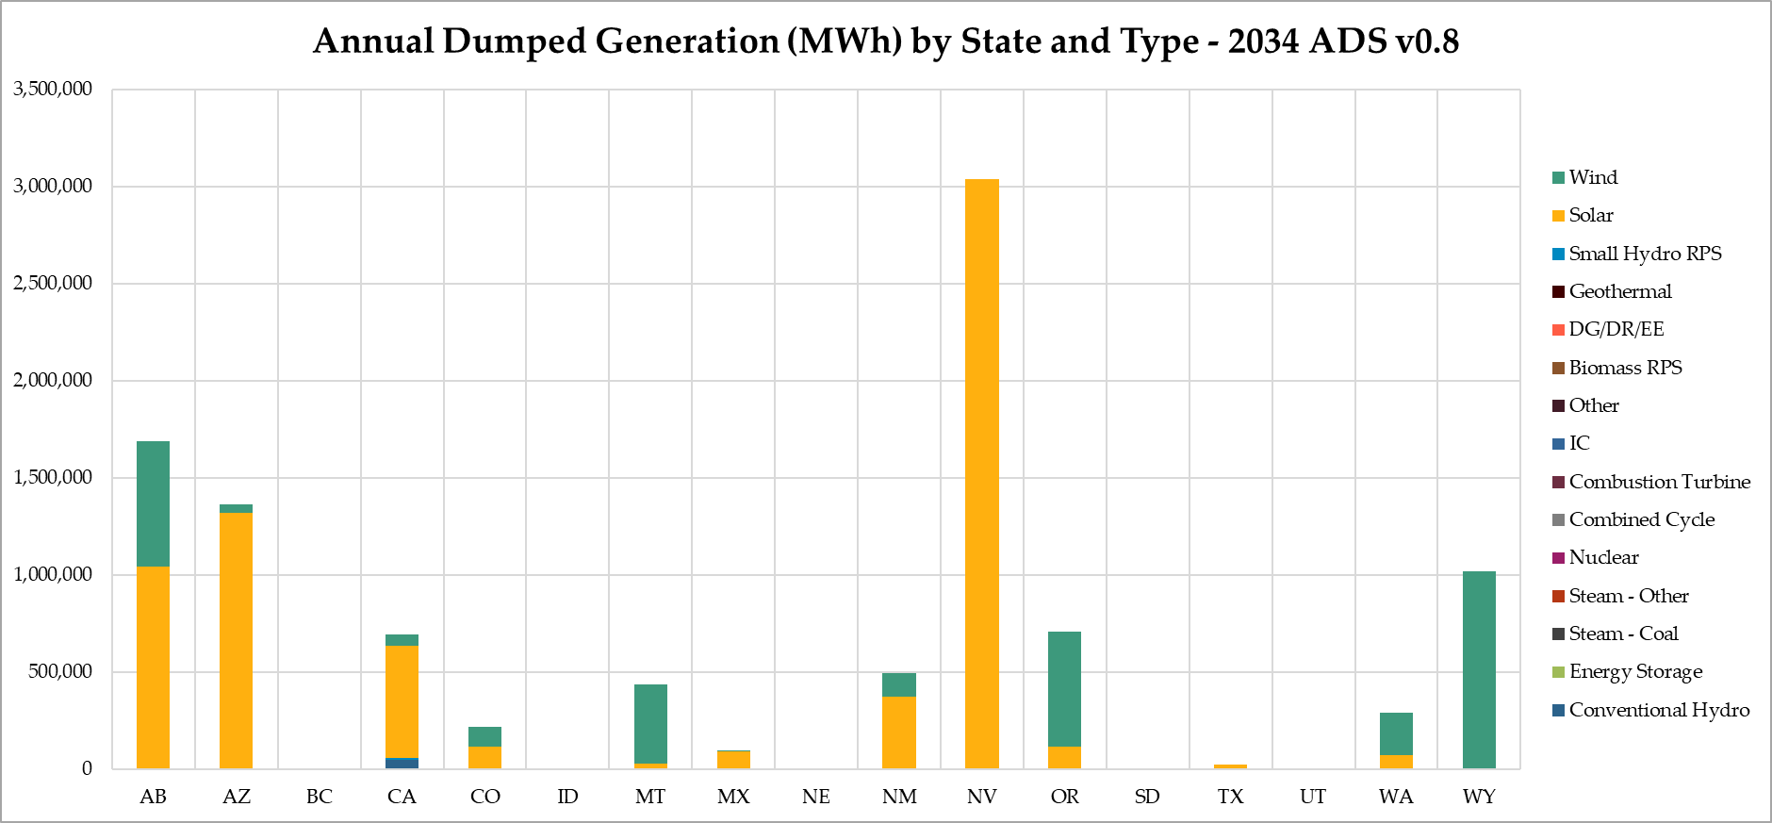
Dumped Generation
Total: 8,542,400 MWh
Curtailment %: 0.78%
Total: 10,071,551 MWh
Curtailment %: 0.83%

Slide 36
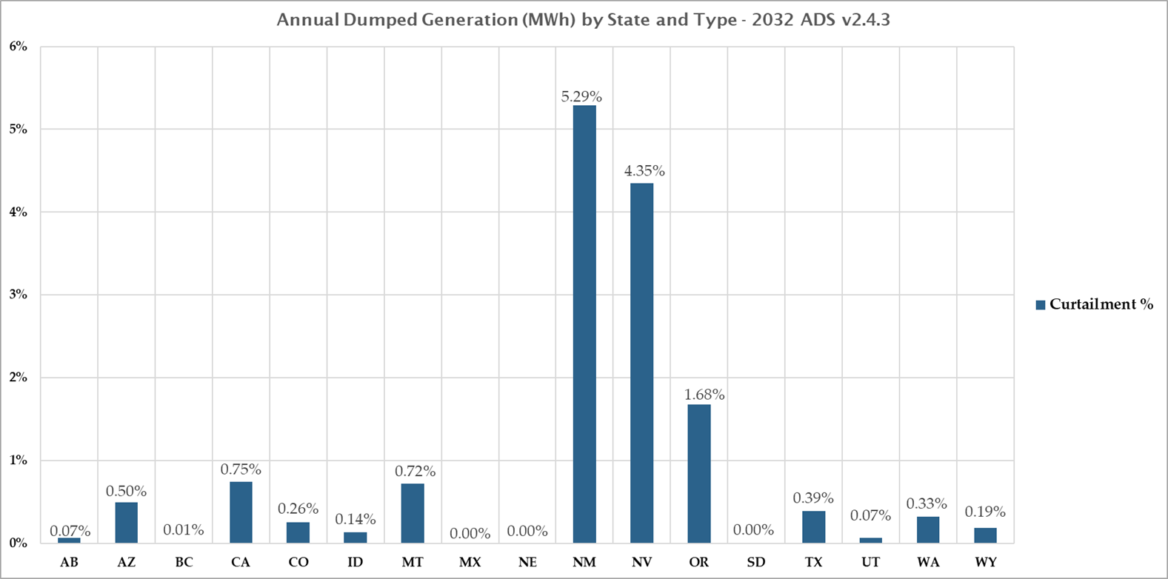

Slide 37
Loads Comparison
9.5% increase from 2032 to 2034

Slide 38
Annual Generation

Slide 39
Energy By Subregion

Slide 40
Capacity

Slide 42
Loads Comparison

