Slide 1
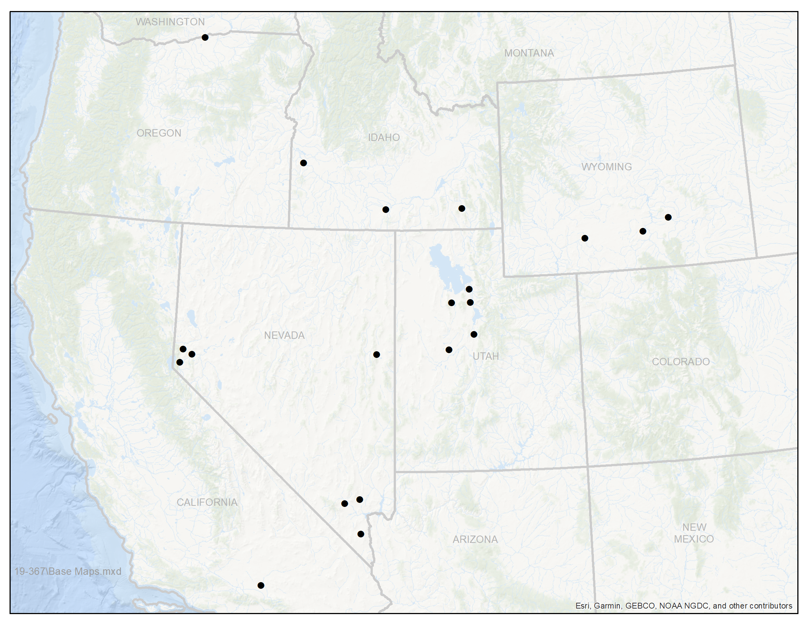
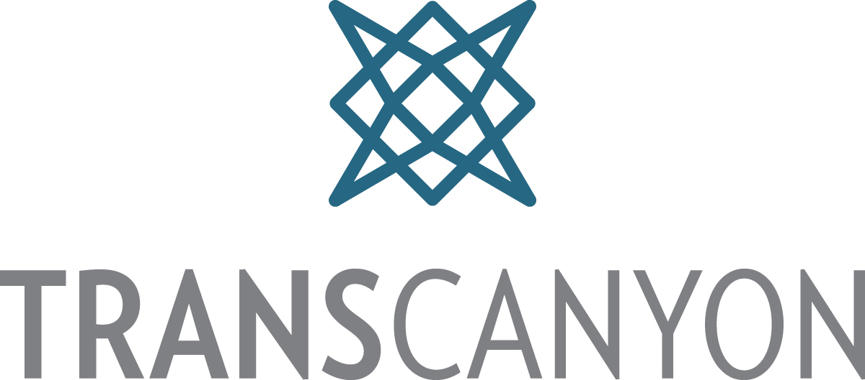
Planned Major Transmission Projects in Relation to Cross-Tie
Boardman
Great Falls
Gateway West (B2H)
PAC & IPC / $1.4B / 2026
Garrison
Aeolus – Anticline #2 (D2.2)
PAC / $582M / 2031
Hemingway
Gateway West (D3)
PAC / $901M / 2031
Midpoint
Windstar
Gateway West (E)
PAC / 2028-2036
Borah
Populus
Bridger/
Anticline
Shirley Basin
Cedar Hill
Aeolus
Gateway Central (TREX-C)
PAC / $938M / 2027
Sinclair
PacifiCorp
SWIP North
LS Power (CAISO) / 2027
Terminal
Gateway South
PAC / $1.8B / 2024
Limber
Oquirrh
Mona
Clover
TransWest Express
Anschutz / 2029
Comstock Meadows
Ft Churchill
Robinson
Mira Loma
IPP
ON Line #2 TBD
Greenlink North
NVE / $839M / 2028
NV Energy
TransCanyon Cross-Tie
$930M / 2028
ON Line
Greenlink West
NVE / $1.3B / 2027
Northwest
Harry Allen (CAISO)
Legend
Dashed Lines are Planned
Solid Lines are Existing
El Dorado
(CAISO)
Adelanto
*Note – Capital Costs are estimates based on TransCanyon’s current understanding. TransCanyon, PacifiCorp and NV Energy costs are all subject to change.

